Slide 1

FLIGHT DELAY ANALYSIS
Yaswanth Atluri
Sruthi Paladugu
Suraj

Slide 2
INTRODUCTION
Air travel is the preferred choice for many due to its unparalleled speed and convenience, especially for covering extensive distances.
Flights can efficiently traverse vast distances within a few hours, a stark contrast to the days or even weeks required by car or train.
Furthermore, air travel stands out by providing a unique level of comfort and luxury not found in alternative modes of transportation.
Modern airplanes come equipped with various amenities, including entertainment systems, comfortable seating, and in-flight meals, enhancing the overall pleasure of the air travel experience.

Slide 3
OBJECTIVE
Evaluate the accuracy of arrival and departure times at various airports.
Identify airports with the lowest and highest numbers of flight cancellations and diversions.
Determine the most common factors contributing to flight delays.
Present a detailed breakdown of delay factors with corresponding percentages.
Compare the prevalence of delay factors among different airports.
Analyze trends in arrival and departure accuracy, cancellations, diversions, and delay factors over time.
Provide recommendations for airports and airlines to improve overall performance.

Slide 4

PROBLEM STATEMENT

Slide 5
PROBLEM STATEMENT
In this project, we are addressing the issue of flight delays and working on predicting these delays. Flight delays are a commonplace issue influenced by various factors.
Some of the factors contributing to delays include:
Delay by the Air Carrier
Weather-Related Delay
Delay within the National Aviation System
Security-Related Delay
Late Arrival of Aircraft
Cancellations
Diversions

Slide 6
DATA
1. Data Compilation:
We've gathered information from the Bureau of Transportation Statistics, spanning flights between 2005 to 2008
2. Dataset Overview:
The dataset comprises 22 columns and 35,318 rows, detailing various delay factors in flight operations.
3. Key Columns:
Notable columns include Year, Month, carrier, carrier_name, airport, airport_name, arr_delay, carrier_delay, weather_delay, nas_delay, and security_delay.
4. Data Preparation for Analysis:
To facilitate the development of our Machine Learning Algorithm for delay analysis, a crucial step involves cleaning the dataset—removing unnecessary columns and rows.

Slide 7
PROJECT PROCEDURE
Step 1: Data Collection and Cleaning
Collect and clean data, removing missing values, unwanted rows, and columns. Ensure data format correctness and store in MongoDB.
Step 2: Integration with Apache Spark
Use MongoDB connector for Apache Spark. Access machine learning libraries for MongoDB. Convert data into RDD.
Step 3: Data Splitting and Model Development
Split data into training and testing sets. Build ML regression model for flight delay prediction. Train model on flight delay data.
Step 4: Model Performance Evaluation
Evaluate model using root mean square method.
Step 5: Model Deployment
Deploy model into MongoDB database for real-time application.

Slide 8
VISUALIZATIONS AND EXPECTED RESULTS
Bar graphs and pie charts for data representation.
Analysis of airports with the highest accuracy in arrival and departure times.
Examination of airports with the lowest and highest numbers of cancellations and diversions.
Identification of the most common factors contributing to flight delays.
Presentation of delay factors with corresponding percentages.

Slide 9
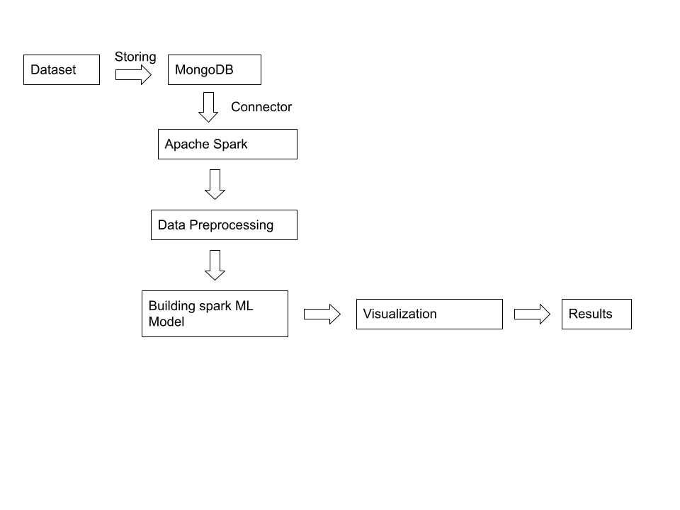
PROPOSED ARCHITECTURE OF PROJECT

Slide 10
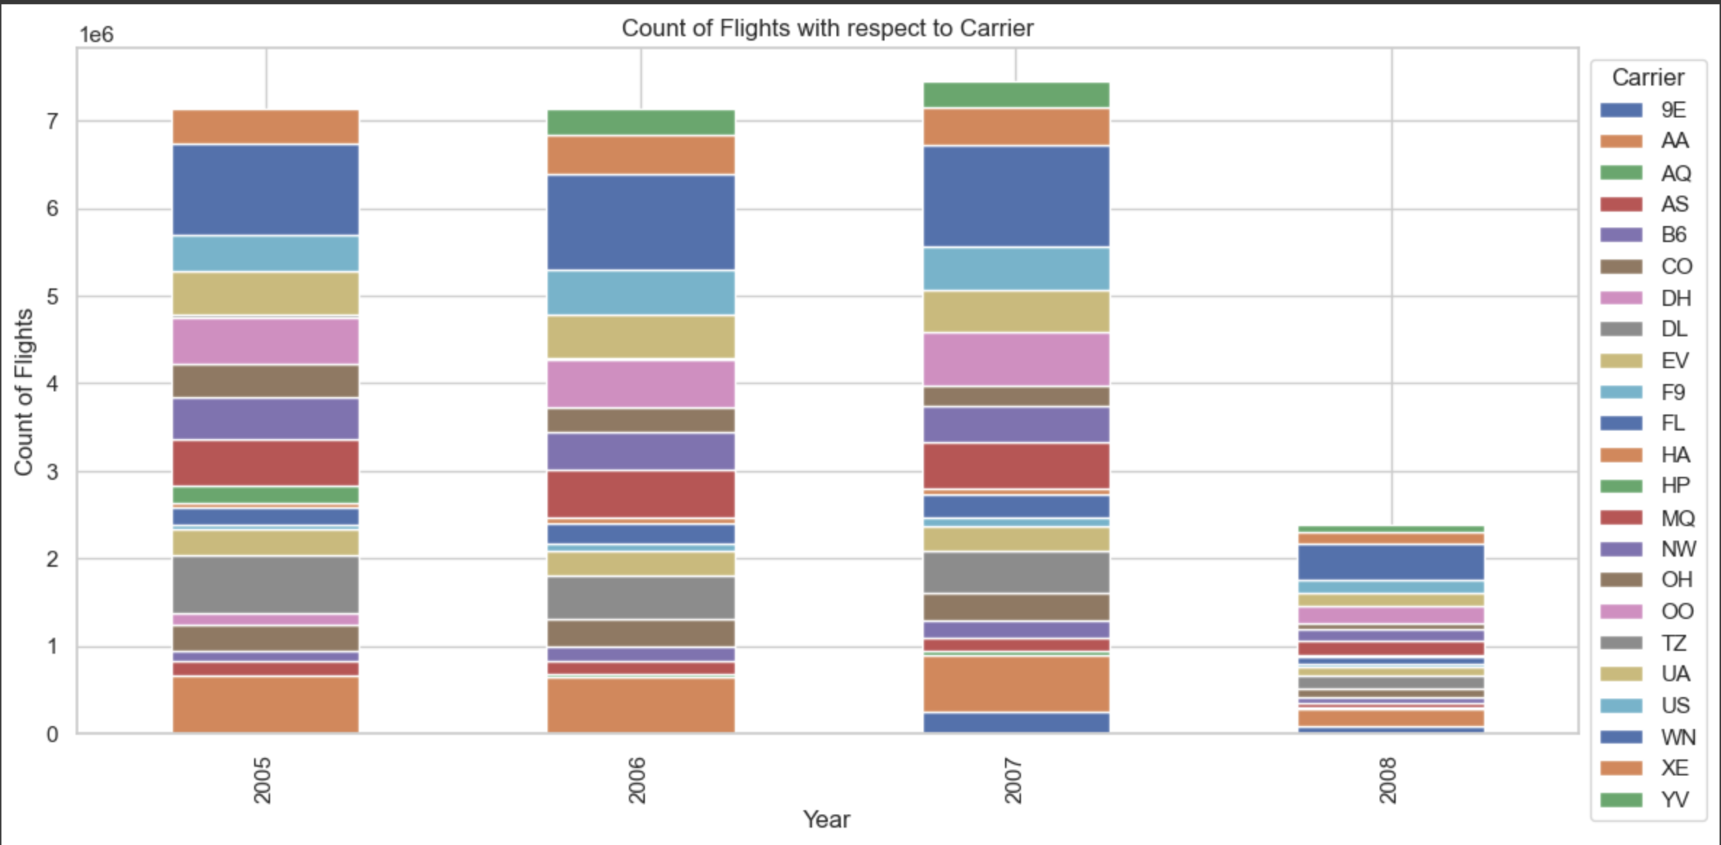
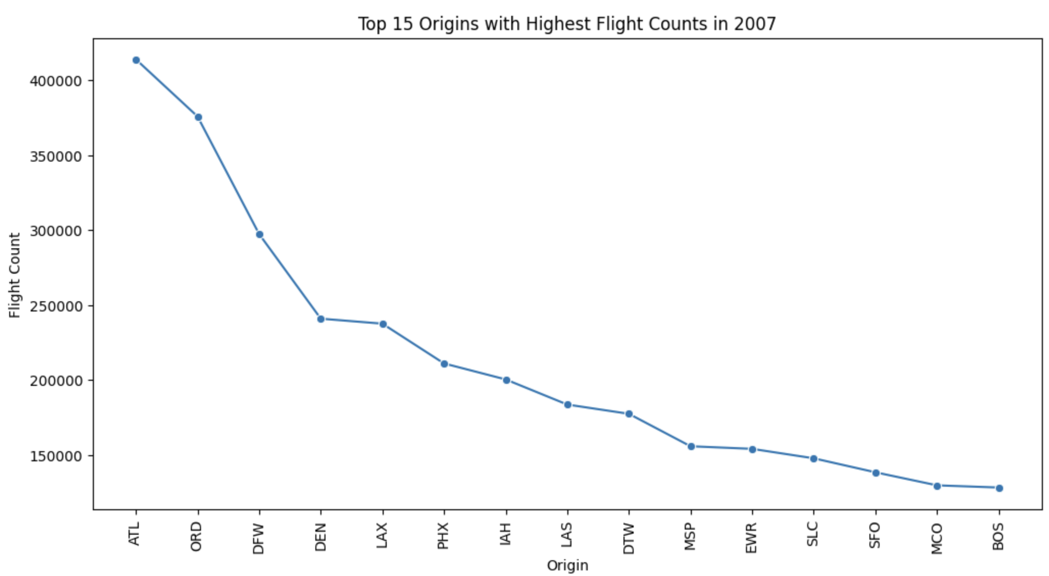
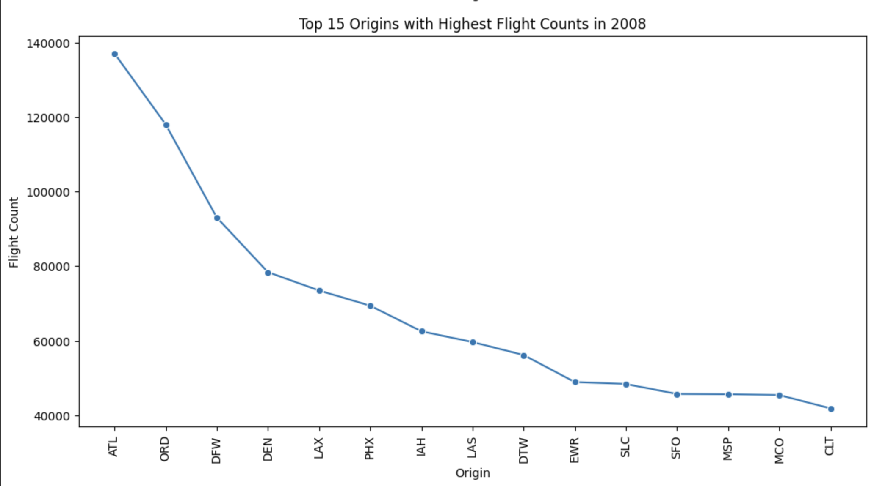
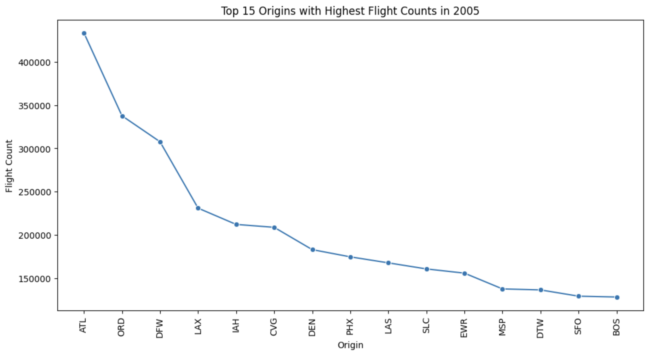

Slide 11
CONCLUSION
Identified primary causes of flight delays: weather, carrier issues, and national aviation system delays.
Data-driven insights from a decade of flight data (2012-2022).
Developed a predictive model with high accuracy in delay prediction.
Root mean square method used for model evaluation.
Insights critical for improving airline scheduling and operational efficiency.
Potential to enhance passenger experience and reduce costs.
Exploring the impact of global events on flight schedules
Useful for strategic planning and management in airlines and airports.

Slide 12
REFERENCES
Bureau of Transportation Statistics. (n.d.). Understanding Flight Delays and Causes. Federal Aviation Administration. Retrieved from https://www.faa.gov/data_research/aviation_data_statistics/
MongoDB. (n.d.). MongoDB Official Documentation. Retrieved from https://docs.mongodb.com/
MongoDB. (n.d.). MongoDB C#/.NET Driver Documentation. Retrieved from https://mongodb.github.io/mongo-csharp-driver/
Apache Spark Documentation. (n.d.). Apache Spark - RDD Programming Guide. Retrieved from https://spark.apache.org/docs/latest/rdd-programming-guide.html
Tableau. (n.d.). Data Visualization Best Practices. Retrieved from https://www.tableau.com/learn/whitepapers/data-visualization-best-practices

